Slide 1

Welcome our class
Teacher: Dang Thi Thuy Lieu

Slide 2


GREETING SONG
Hello teacher!!!

Slide 3





WEATHER REPORT

Slide 4

Let’s review
Look and say

Slide 5

mom

Slide 6
dad

Slide 7
brother

Slide 8
sister

Slide 9
grandma

Slide 10
grandpa

Slide 11
Let’s review

Slide 12
PLAY GAME
Passing ball!

Slide 13

Saturday , December 15th 2017
Lesson : Animals

Slide 14

The aim of the lesson:
1. Listen, point and repeat
2. Practice
3. Consolidation
4. Story time

Slide 15
The aim of the lesson:
1.Listen, point and repeat.
1. Look and say
2. Practice
3. Play games
4. Match

Slide 16

dog

Slide 17
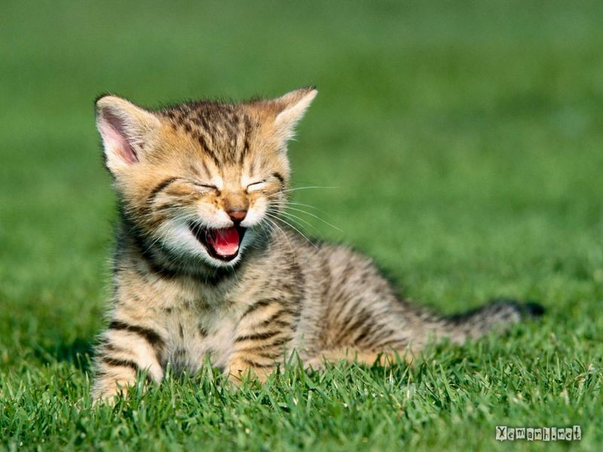
cat

Slide 18
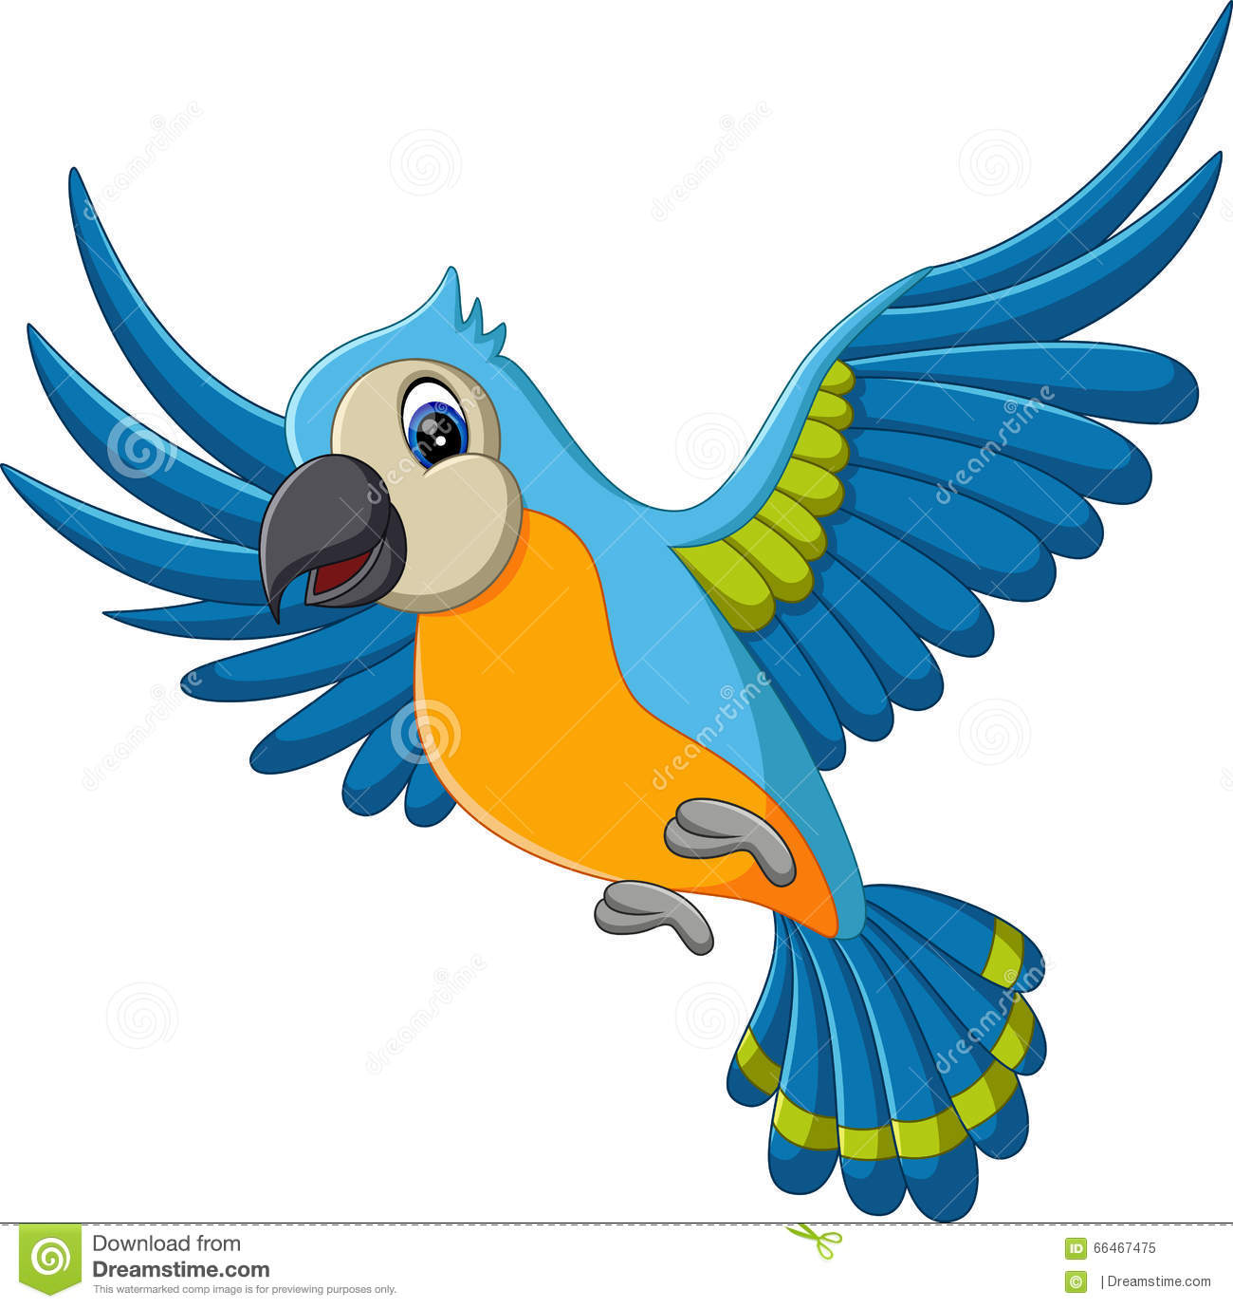
bird

Slide 19
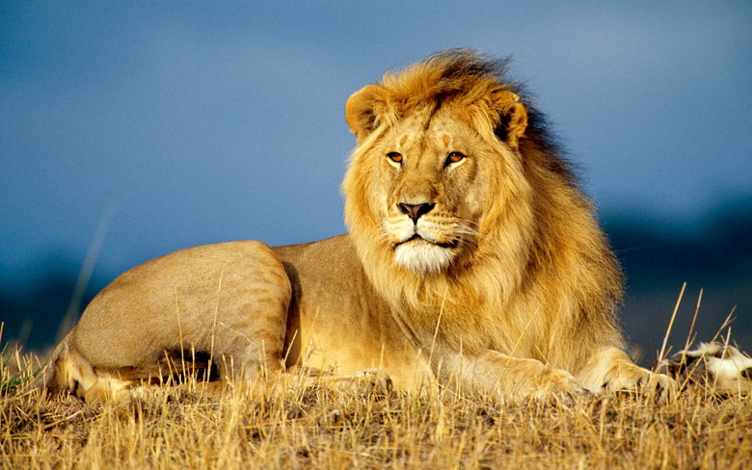
lion

Slide 20
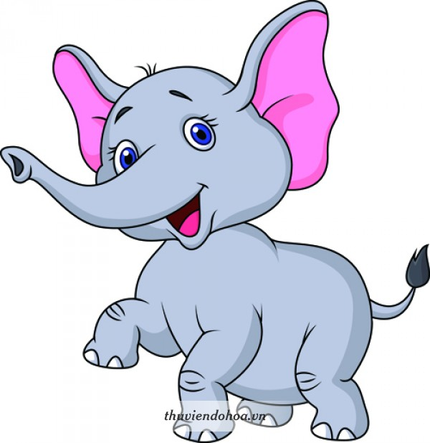
elephant

Slide 21

Break time
Let’s sing a song: Baby shark!

Slide 22
2. Practice
PLAY GAME
Guessing

Slide 23
Next Slide
Remove Box

Slide 24
Next Slide
Remove Box

Slide 25
Next Slide
Remove Box

Slide 26

Next Slide
Remove Box

Slide 27
Next Slide
Remove Box

Slide 28

3.Consolidation

Slide 29
Listen and guess .

Slide 30
dog

Slide 31
bird

Slide 32
elephant

Slide 33
cat

Slide 34
lion

Slide 35

A.
This is a…PEN
B.

Slide 36


Slide 37
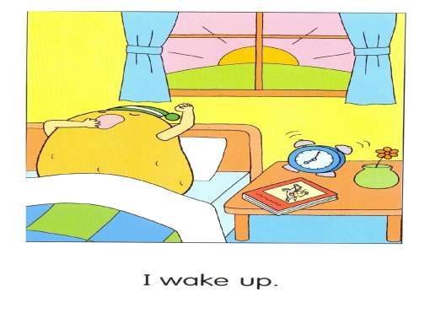

Slide 38
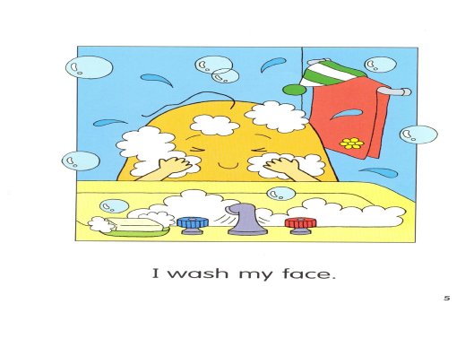

Slide 39
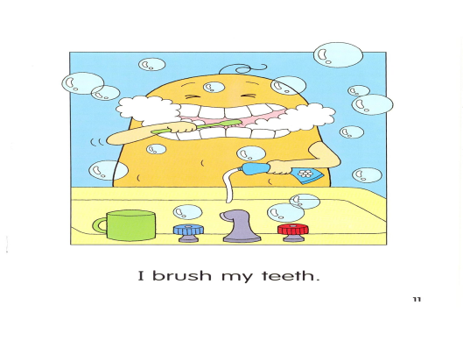

Slide 40
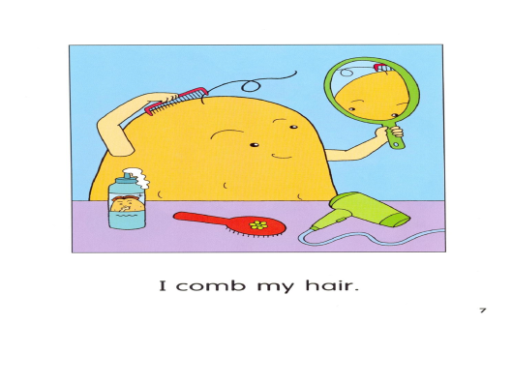

Slide 41
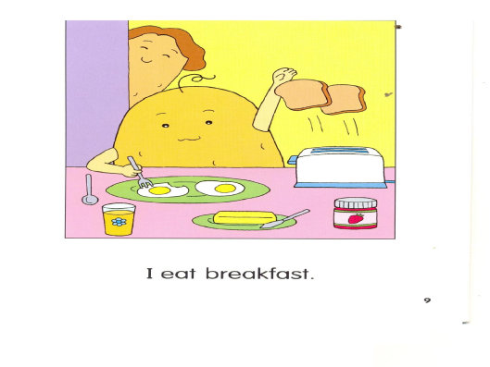

Slide 42
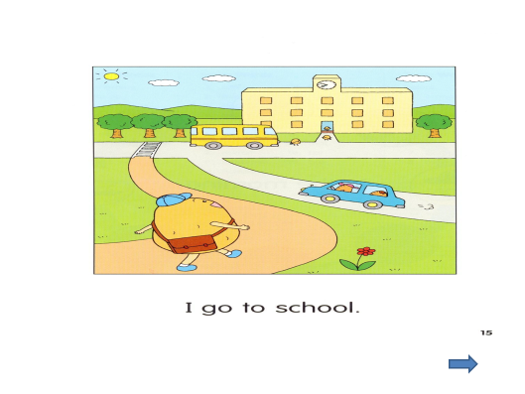

Slide 43

SUM UP

Slide 44

THE GOODBYE SONG

Slide 45

THANK YOU!

